Slide 1
Introduction to Amazon AWS
Brian Korzynski

Slide 2
About Me
Principal Architect – Iron Mountain
Owner of Korzynski LLC
Professional Developer for 9+ years
Windows Forms
Web
Mobile
SQL Optimization
Data Analysis
Mathematics
Big Data
Cloud
Machine Learning

Slide 3
Why This Talk?
Explain what AWS is and what they have to offer
Show that you can be up and running in the cloud today for free
Provide source code to help you utilize the AWS services
Lack of good documentation for .Net (very sparse and not easy to follow, until recently)

Slide 4
Cloud in General
Secure
Durable
Highly-Scalable
Highly-Available
Pay only for what you use
No minimums or setup fees
Always up to date

Slide 5
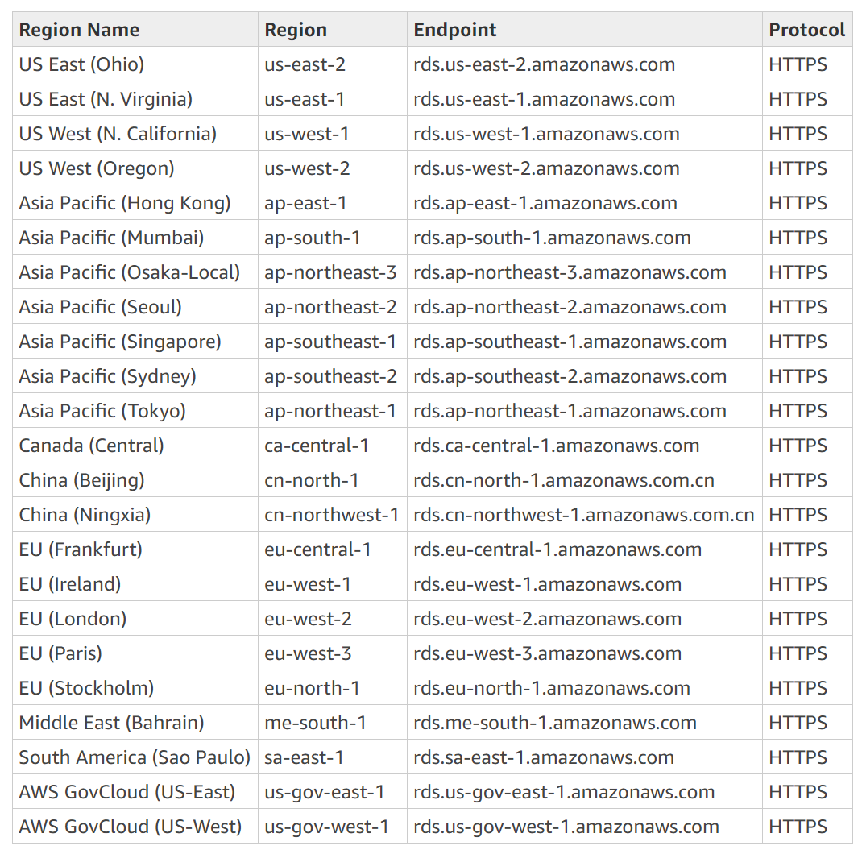
Regions
Physical locations of the Amazon data centers
Today I will be using the Oregon data center (us-west-2)
List is always changing so visit https://docs.aws.amazon.com/AmazonRDS/latest/UserGuide/Concepts.RegionsAndAvailabilityZones.html for the latest

Slide 6
Before We Begin
Console
Identity & Access Management (IAM)
Gives the .Net SDK access to the services
DEMO
NuGet Package
Old Way – AWSSDK
New Way – AWSSDK.Core +
AWSSDK.S3
AWSSDK.SQS

Slide 7
S3
File and blob storage
Think of this as a virtual file system in which you can have folders (buckets) and files (objects)
Costs about $.023 per GB of data stored + $.005 per 1,000 requests
My S3 with 1,000,000+ documents runs me about $1 a month
Demo

Slide 8
SQS
Queueing service
Supports simple queueing strategies (e.g. topics)
Messages must be serialized to a string
Max message size = 256kb
Max number of messages = how ever big your wallet is
Costs about $0.4 per million requests (first million are free) for outbound and all inbound is free
A request can have up to 10 messages
My SQS with around 30,000,000 messages at a time runs me about $5 a month
Demo

Slide 9
SNS
Push Notification Service
Mobile devices
Email
Other Distributed Systems
Pricing:
Mobile - $.50 per million
SMS – use the calculator
Email - $2.00 per 100,000
HTTP - $.60 per million
SQS & Lambda – free
Data Cost - $.09 / GB
My SNS is free since I utilize less than 100 SMS and less than 1,000 emails per month

Slide 10
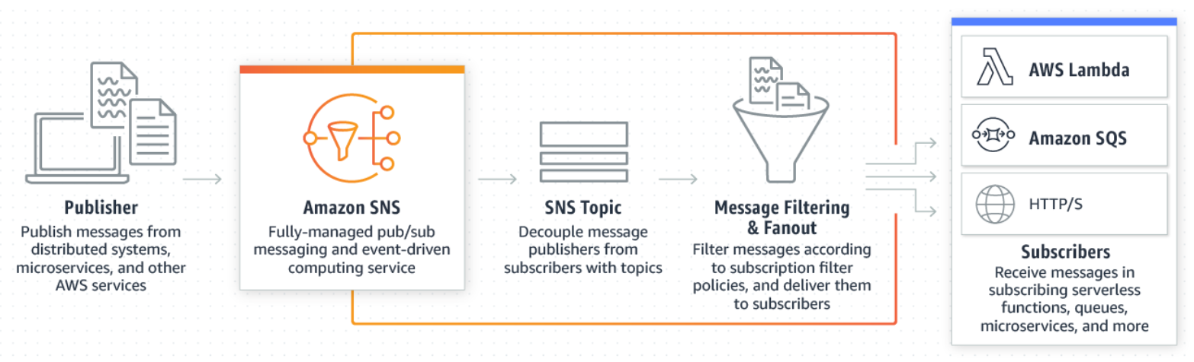
SNS Workflow & Demo

Slide 11
SES
Outbound only email sending service
Very useful when sending out massive amounts of emails
Gets around spam filtering
Tracks bounce backs
Pricing:
$.10 per thousand
$.12 per GB of attachments
My SES costs be $.22 a month since I am sending emails with several attachments

Slide 12
EC2
VM’s
You can do what ever you want, however you have to manage the IT side e.g. updates

Slide 13
Pro Tips
Name your buckets, queues, topic etc. with only lower-case letters
This has caused problems for me in the past
If you need to store large amounts of data within a queue to process, then store the object in S3 and only add the bucket and object name (concatenated) to the queue
When storing large amounts of serialized data (strings) in S3 I would recommend you compress them to save space and money
Prefer services (i.e. SQS, S3, SNS, etc.) to VM’s
This way they handle the updates and scaling
When possible, keep all of your services within the same region, as this cuts down on latency
Don’t be afraid to experiment Amazon AWS is incredibly cheap (especially compared to Azure) and most of the time you will fall into the free tier
All of my Amazon costs me about $6.22 per month

Slide 14
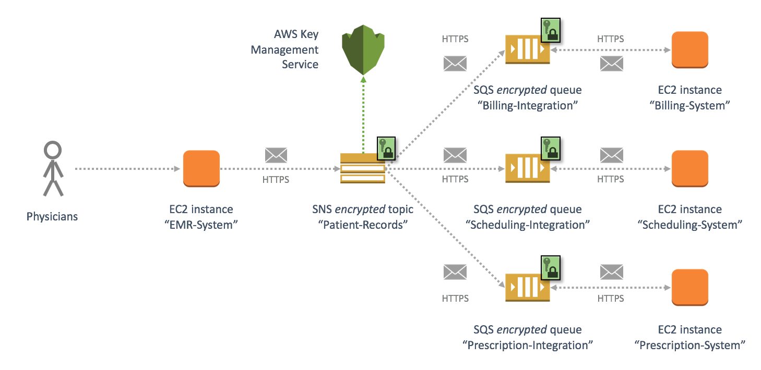
Example Architecture – Doctors Office ERP

Slide 15
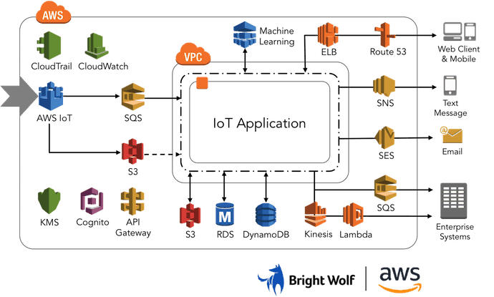
Example Architecture 2 – Mobile Game

Slide 16
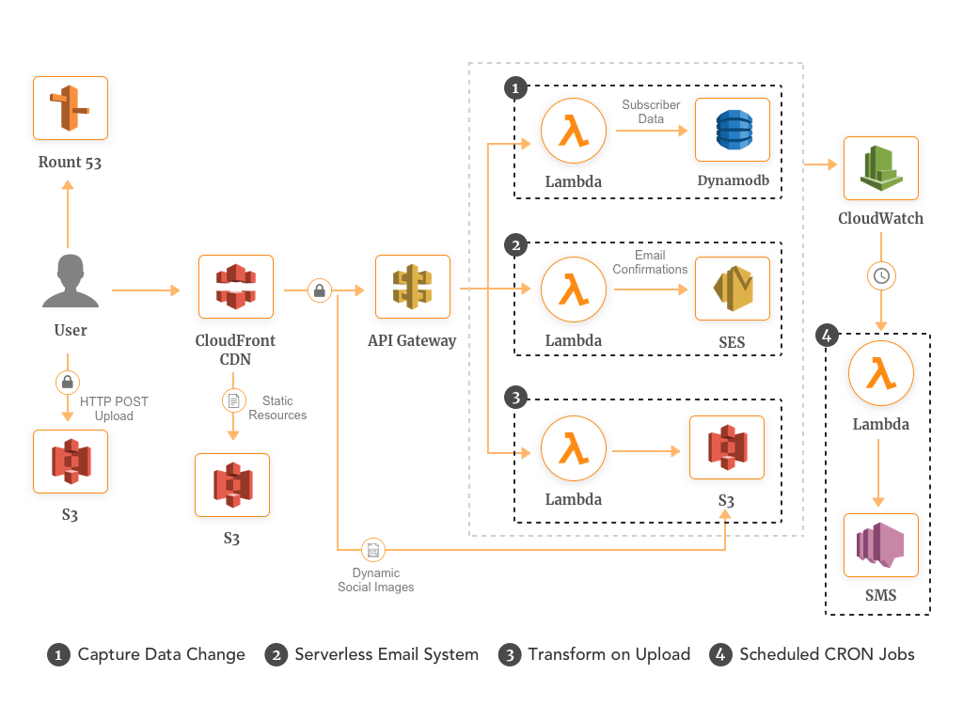
Example Architecture 3 – Large Web App

Slide 17
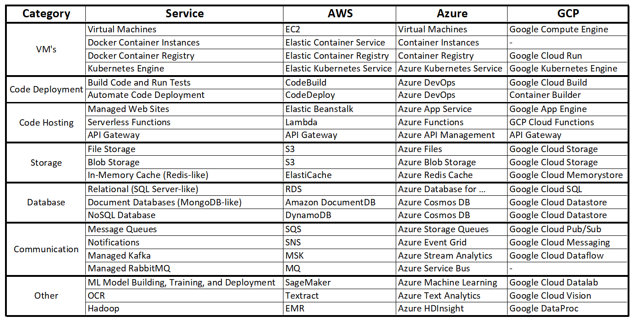
Comparative Cloud Services

Slide 18
Questions
http://www.github.com/korz
@bkorzynski
Links
.Net SDK - https://aws.amazon.com/sdk-for-net/
API Reference - https://docs.aws.amazon.com/sdkfornet/v3/apidocs/index.html
Reference Guides - https://docs.aws.amazon.com/
S3 – https://docs.aws.amazon.com/AmazonS3/latest/userguide/Welcome.html
SQS – https://docs.aws.amazon.com/AWSSimpleQueueService/latest/SQSDeveloperGuide/welcome.html
SNS – https://docs.aws.amazon.com/sns/latest/dg/welcome.html
EC2 – https://docs.aws.amazon.com/AWSEC2/latest/UserGuide/concepts.html
Lambda - https://docs.aws.amazon.com/lambda/latest/dg/welcome.html
There is a talk on AWS Lambda at 3:05 in 301B

